Slide 1
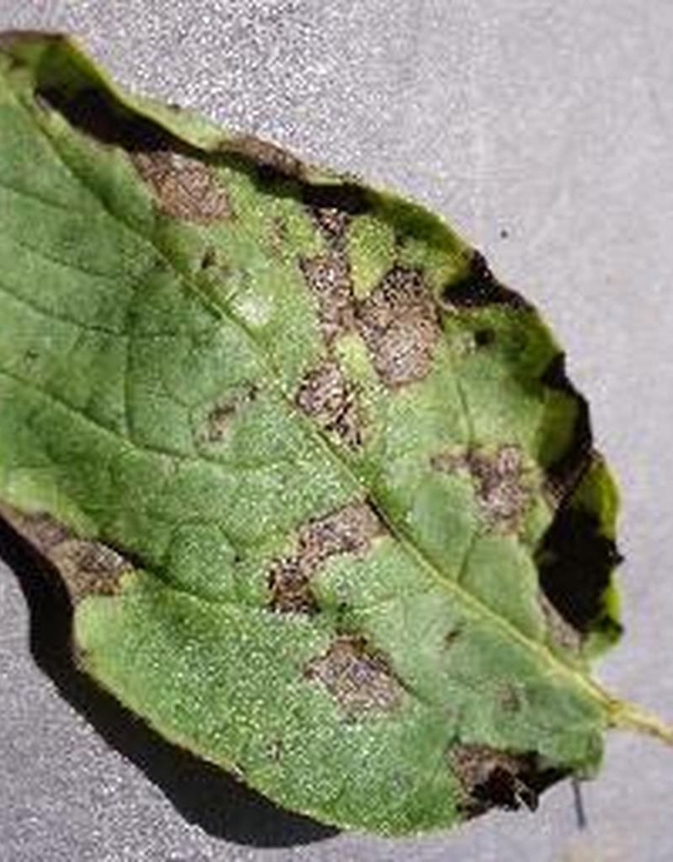
PLANT DISEASE DETECTION
Solanaceae crops using Image Processing, MobileNetV2 and Grad-CAM
Project on IPCV

Slide 2
TEAM MEMBERS
Vartika 20233306
Vaishnavi 20233301
Yashshree 20233324
Yamini 20233320

Slide 3
CONTENTS
Introduction
Motivation
Our Approach
K-Means Segmentation
MobileNetV2
Grad-CAM
Dashboard
Dataset and Classes
Results
Limitations and Future Scope
Conclusion

Slide 4
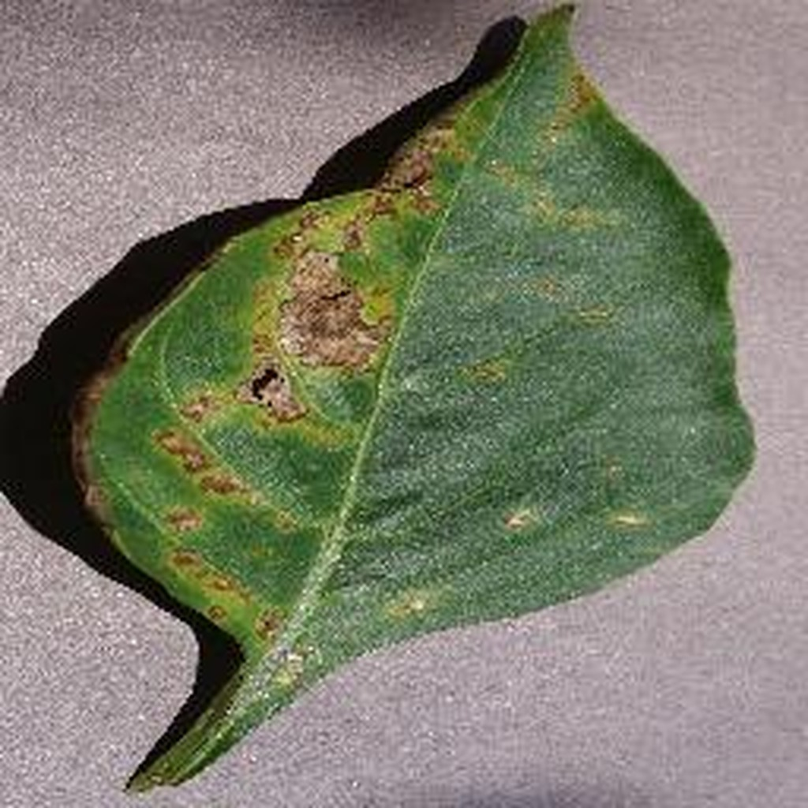
INTRODUCTION
Tomatoes, potatoes and peppers are staple crops, grown and eaten all over the world.
Leaf diseases like Late Blight and Early Blight can wipe out a harvest within days if nobody catches them.
Smallholder farmers rarely have a pathologist nearby, so treatment often comes late or goes wrong.

Slide 5
MOTIVATION
A classifier can be 99% sure and still be looking at the wrong thing.
Standard deep learning models behave like black boxes. They can name a disease with high confidence while actually focusing on background dirt, lighting artifacts or the markers on a greenhouse bench.
So we wanted a system that names the disease, measures how severe it is, and shows where the model was looking.

Slide 6
OUR APPROACH
01
02
03
Classical IPCV
Deep Learning
Explainable AI
Unsupervised
Supervised
Grad-CAM
K-Means colour segmentation in CIELAB isolates the lesions and gives a severity percentage.
A fine-tuned MobileNetV2 classifies 9 disease classes and is light enough for edge devices.
A heatmap shows whether the network is looking at the same lesions that K-Means found.

Slide 7
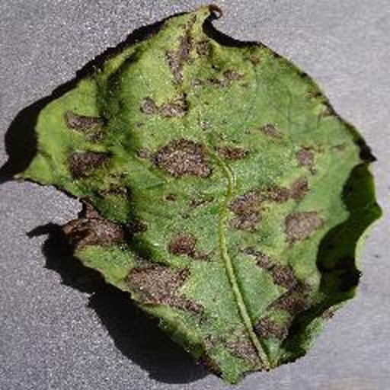
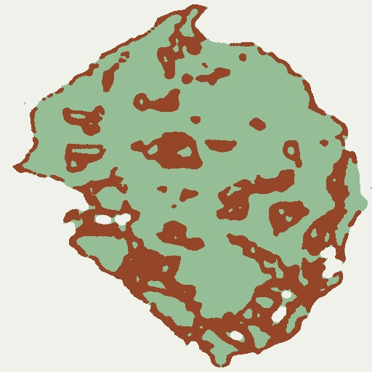
K-MEANS SEGMENTATION
1 Convert to CIELAB. Separating luminance from colour keeps field lighting from breaking the segmentation.
2 Cluster with K = 3. cv2.kmeans() splits pixels into background, healthy leaf and lesion.
3 Clean up. Morphological opening removes noise, then bitwise-AND masking extracts the lesion patches.
Input leaf
K = 3 result
Severity (%)
lesion ÷ leaf pixels × 100

Slide 8
MOBILENETV2
~3.5M
Inverted residual blocks with depthwise separable convolutions keep it light.
Small enough for mobile devices and single-board computers.
Fine-tuned with differential learning rates, 0.2× the base LR for the backbone and 2.0× for the classification head, on a cosine annealing schedule.
parameters

Slide 9
GRAD-CAM
1 Hook into the last convolutional block, model.features[-1], which has 1280 feature channels.
2 Back-propagate gradients from the predicted class.
3 Average the gradients over space to get one weight per channel.
4 Combine the weighted maps into a coarse heatmap.
0.6 × ORIGINAL
+ 0.4 × JET HEATMAP
The overlay we show on every leaf, so you can check the model's attention against the real lesions.

Slide 10
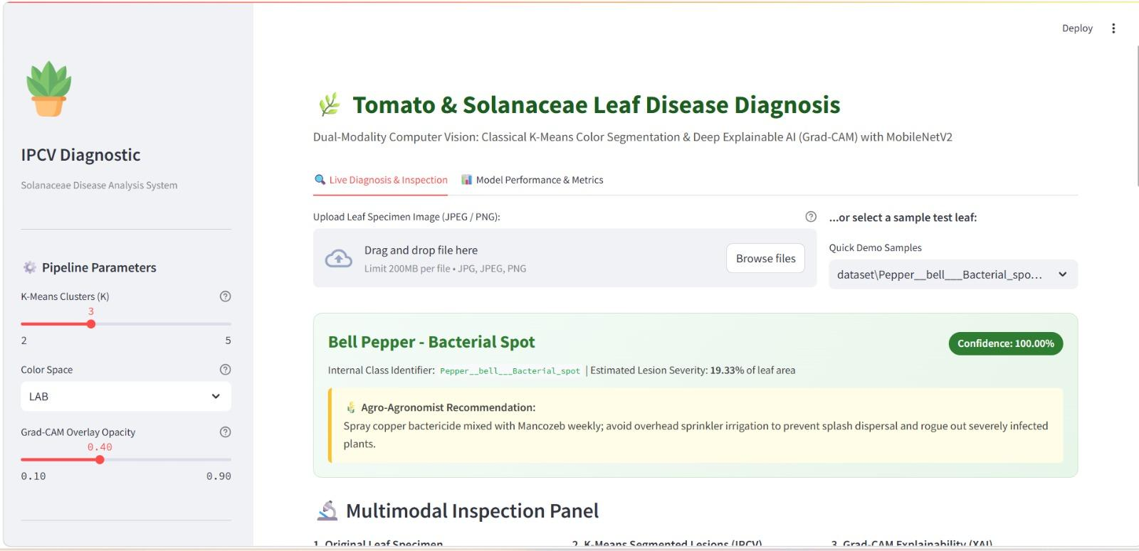
STREAMLIT DASHBOARD
Live inspection
Drag and drop a leaf image, or pick a quick-demo sample.
Agronomist advice
Automatic recommendations for each diagnosed disease.
Three-panel viewer
Raw leaf, K-Means lesions and Grad-CAM, side by side.
Performance tab
Confusion matrix and classification metrics from saved evaluations.

Slide 11
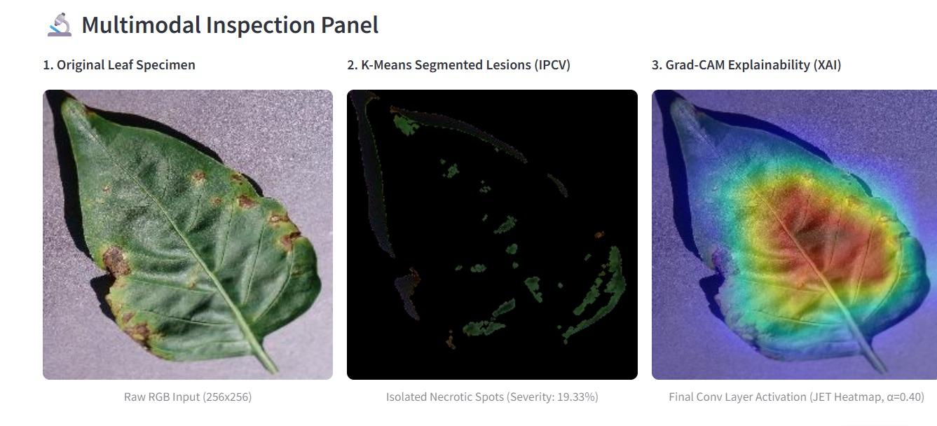

Slide 12
DATASET AND CLASSES
12,335 PlantVillage images, split 70 / 15 / 15 with stratification
8,634
1,850
1,851
train
validation
test
Bell Pepper
Potato
Tomato
Bacterial spot
Healthy
Early blight
Late blight
Healthy
Early blight
Late blight
Yellow Leaf Curl Virus
Healthy

Slide 13
RESULTS
99.78%
0.0077
test loss (cross-entropy)
0.998
macro average F1-score
overall test accuracy
1,847 of 1,851 test images classified correctly
0.998
weighted average F1-score

Slide 14
PER-CLASS REPORT
Class | Precision | Recall | F1-score | Support
Bell Pepper: Bacterial Spot | 0.993 | 1.000 | 0.997 | 152
Bell Pepper: Healthy | 1.000 | 0.996 | 0.998 | 249
Potato: Early Blight | 1.000 | 1.000 | 1.000 | 162
Potato: Late Blight | 1.000 | 0.993 | 0.997 | 146
Potato: Healthy | 1.000 | 1.000 | 1.000 | 18
Tomato: Early Blight | 0.992 | 1.000 | 0.996 | 126
Tomato: Late Blight | 0.996 | 0.993 | 0.995 | 279
Tomato: Yellow Leaf Curl Virus | 1.000 | 1.000 | 1.000 | 473
Tomato: Healthy | 0.996 | 1.000 | 0.998 | 246
Overall (weighted) | 0.998 | 0.998 | 0.998 | 1,851

Slide 15
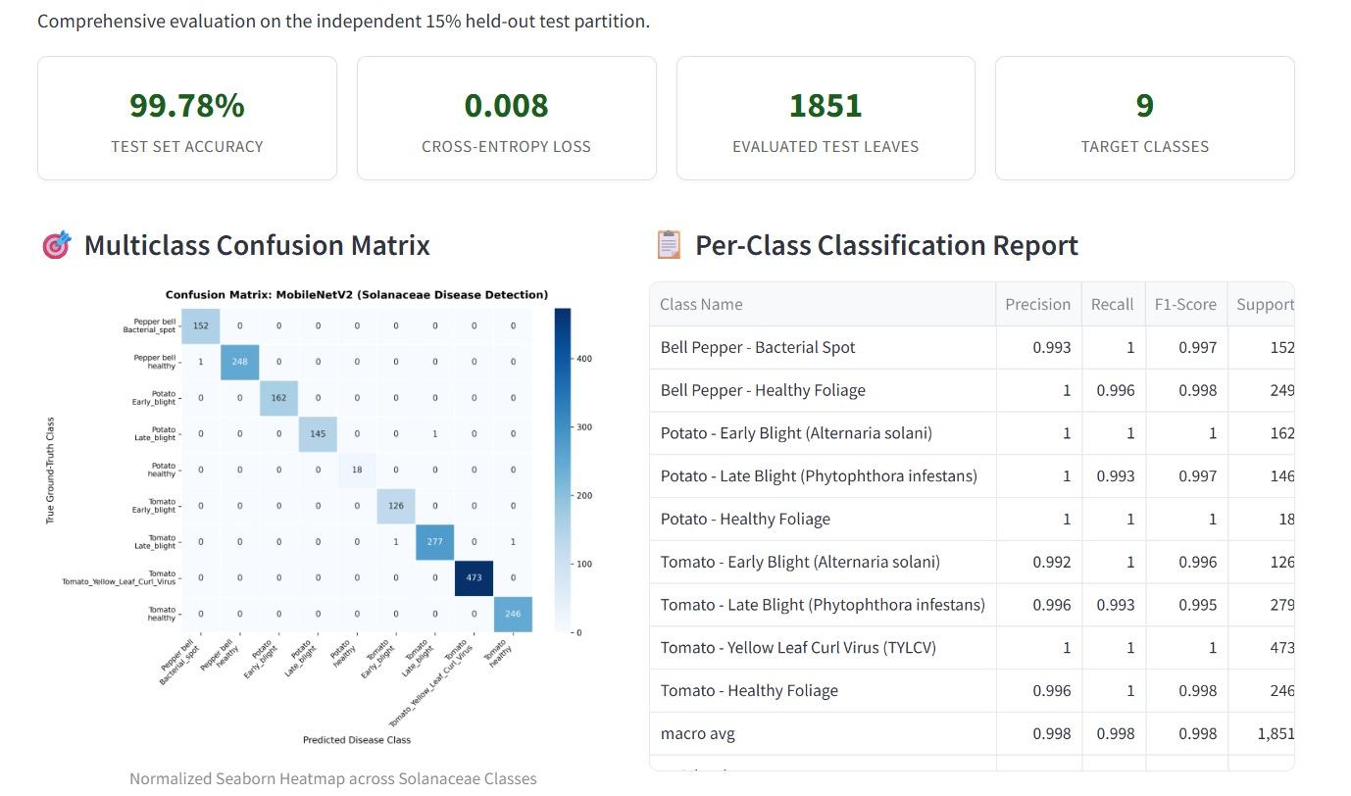

Slide 16
LIMITATIONS & FUTURE SCOPE
Lab vs. field images
PlantVillage shows single leaves on plain backgrounds. Real fields have overlapping leaves, soil, weeds and glare. Next step: train on in-the-wild data like PlantDoc.
Micro-lesions
K-Means struggles with the earliest symptoms, such as bacterial pinpricks under 5 pixels. Multi-scale feature pyramids or attention gates could help.
Edge deployment
Quantize the ~3.5M-parameter model to INT8 (PyTorch or ONNX Runtime) and run it offline on a Raspberry Pi 4/5 or an Android app.

Slide 17
CONCLUSION
Segmentation tells us how bad it is.
MobileNetV2 tells us what it is, with 99.78% test accuracy.
Grad-CAM shows us why.
Together they turn a black-box prediction into something a farmer can check and trust.

Slide 18
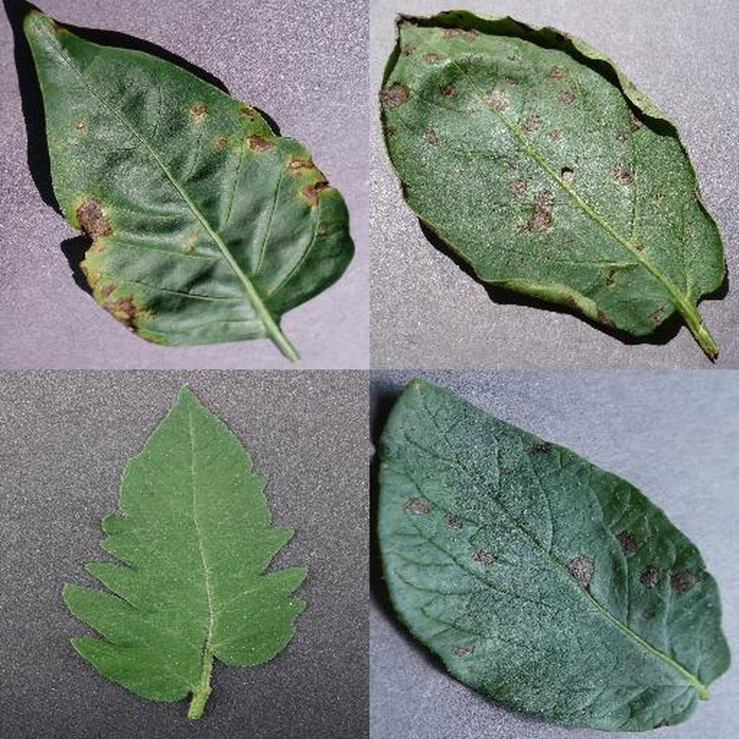
THANK YOU

